Slide 1


SQL vs NoSQL
Explanation in Tamil

Slide 2
What is
SQL
NoSQL

Slide 3
SQL
Structured Query Language
Access and manipulate databases
Used to communicate with database
RDMS stores related information across tables
Popularly used RDBMS databases (Oracle, mysql, PostgreSQL, MSSQL)

Slide 4
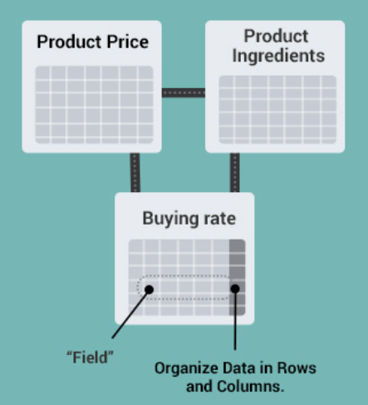
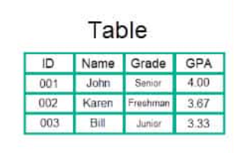
SQL

Slide 5
NoSQL
Non Relational DBMS
Not require a fixed schema
Distributed data storage with voluminous data
Used for Big data, Real time web apps
Popularly used (MongoDB, CosmosDB, Cassandra, HBase)

Slide 6
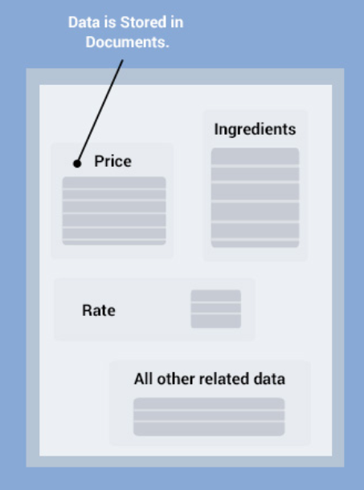
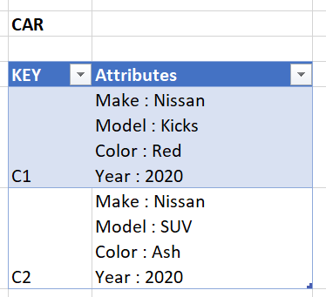
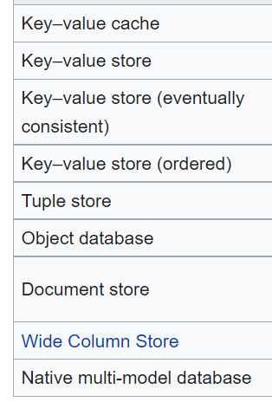
NoSQL

Slide 7
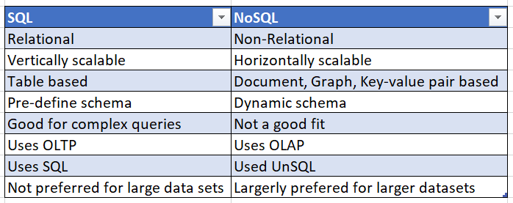
SQL vs NoSQL

Slide 8
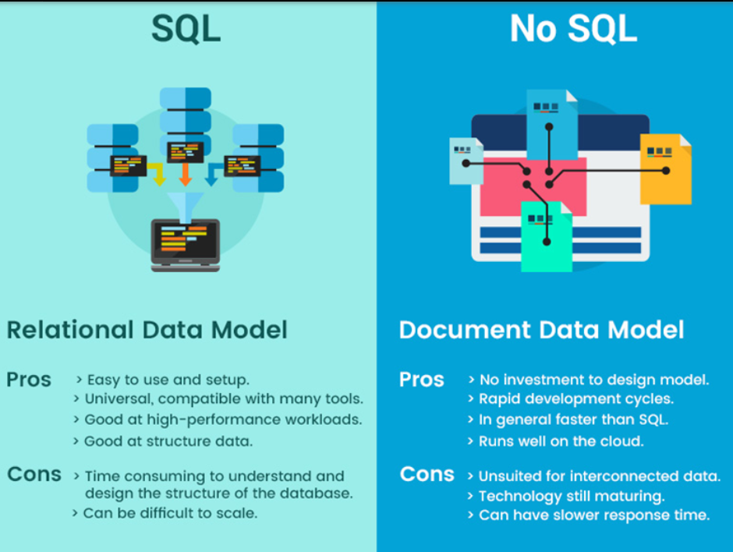
SQL vs NoSQL

Slide 9
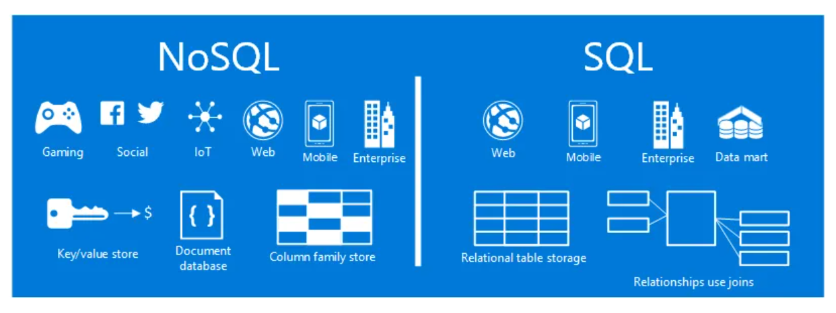
SQL vs NoSQL Use Cases

Slide 10
SQL is everywhere
SQL is in demand
SQL is still the top language for data work
So, what’s the best way to learn SQL?

Slide 11
Review

